Slide 1


Mobile Phone Security
Dr. Digvijaysinh Rathod
Associate Professor & Associate Dean
School of Cyber Security and Digital Forensics
National Forensic Sciences University with status of Institution of National Importance
digvijay.rathod@gfsu.edu.in

Slide 2
Frida
Frida
Dynamic instrumentation toolkit for developers, reverse-engineers, and security researchers
Dr. Digvijaysinh Rathod

Slide 3
What is frida ?
Frida’s core is written in C
it’s a dynamic code instrumentation toolkit.
Scriptable:
It lets you inject snippets of JavaScript or your own library into native apps on Windows, macOS, GNU/Linux, iOS, Android, and QNX.
Frida also provides you with some simple tools built on top of the Frida API.
These can be used as-is, tweaked to your needs, or serve as examples of how to use the API.
Ref: https://frida.re/docs/home/
Dr. Digvijaysinh Rathod

Slide 4
What is frida ?
Portable: Works on Windows, macOS, GNU/Linux, iOS, Android, and QNX.
Free: Frida is and will always be free software.
Battle-tested: Frida has a comprehensive test-suite and has gone through years of rigorous testing across a broad range of use-cases.
Ref: https://frida.re/docs/home/
Dr. Digvijaysinh Rathod

Slide 5
Why a Python API, but JavaScript debugging logic?
Frida’s core is written in C and injects QuickJS into the target processes, where your JS gets executed with full access to memory, hooking functions and even calling native functions inside the process.
There’s a bi-directional communication channel that is used to talk between your app and the JS running inside the target process.
Ref: https://frida.re/docs/home/
Dr. Digvijaysinh Rathod

Slide 6
Why a Python API, but JavaScript debugging logic?
Using Python and JS allows for quick development with a risk-free API. Frida can help you easily catch errors in JS and provide you an exception rather than crashing.
You can use Frida from C directly, and on top of this C core there are multiple language bindings, e.g. Node.js, Python, Swift, .NET, Qml, etc. It is very easy to build additional bindings for other languages and environments.
Ref: https://frida.re/docs/home/
Dr. Digvijaysinh Rathod

Slide 7
Why a Python API, but JavaScript debugging logic?
Common purpose of Frida,
Spy on Crypto APIs
Modify function’s output
Bypass SSLPinning and Root detection
Trace private application code
Bypass various software sided locks (like applock)
Ref: https://frida.re/docs/home/
Dr. Digvijaysinh Rathod

Slide 8
Installation – frida server in Genymotion
Python – latest 3.x is highly recommended
Create Genymotion android device with API > 7.0 otherwise you face frida installation issues. Ping Genymotion AVD from Kali
Sever installation in the Genymotion:
Find the android device CPU architecture
Query all configuration information of Android devices: adb shell getprop.
>adb shell getprop
>adb shell getprop | grep abi
>adb shell getprop ro.product.cpu.abi
Genymotion Emulator shows its X86 CPU architecture
Dr. Digvijaysinh Rathod

Slide 9
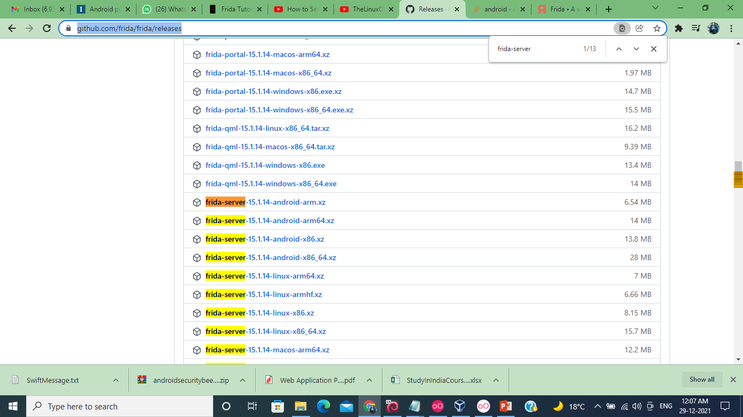
Installation – frida server in Genymotion
Visit : https://github.com/frida/frida/releases
Search for frida-server key word in the webpage
Dr. Digvijaysinh Rathod

Slide 10
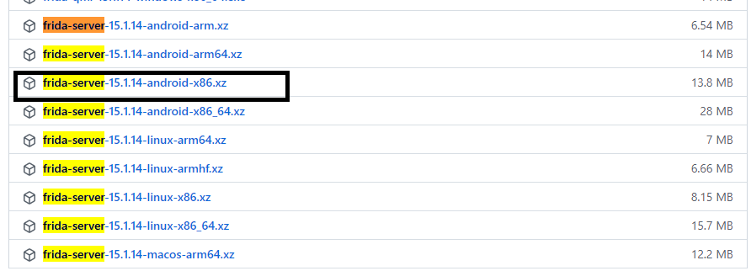
Installation – frida server in Genymotion
Download suitable version of Frida-server. In this case as we have X86 CPU architecture so I downloaded following version,
Dr. Digvijaysinh Rathod

Slide 11
Installation – frida server in Genymotion
Unzip the frida-sever-15-14-1-android.xz & rename the file as frida-server
> adb connect ip-address-of-genymotion-AVD
>adb devices
>adb push frida-server /data/local/tmp
# check the location of Frida-server file
>adb shell
root-android > cd /data/local/tmp
# check that frida-server file is there or not
Dr. Digvijaysinh Rathod

Slide 12
Installation – frida server in Genymotion
root-android/data/local/tmp> chmod 755 frida-server
root-android/data/local/tmp> ./frida-sever
frida server will start and waiting for frida client to connect.
If you receive any error such as
reloc_library [1311] : 1319 cannot locate “getauxval”……
CANNOT LINK EXECUTABLE
It means you are using ancient versions of Android
Ref: https://frida.re/docs/android/
Dr. Digvijaysinh Rathod

Slide 13
Installation – frida in the kali or santoku
> sudo pip install frida or
>sudo pip install frida-tools
> sudo pip3 install frida
# once it’s install successful then test the Friday
>frida-ps –U
>frida-ps this will show the module.
# if you find list of module, it shows that frida is working.
Dr. Digvijaysinh Rathod

